Slide 1

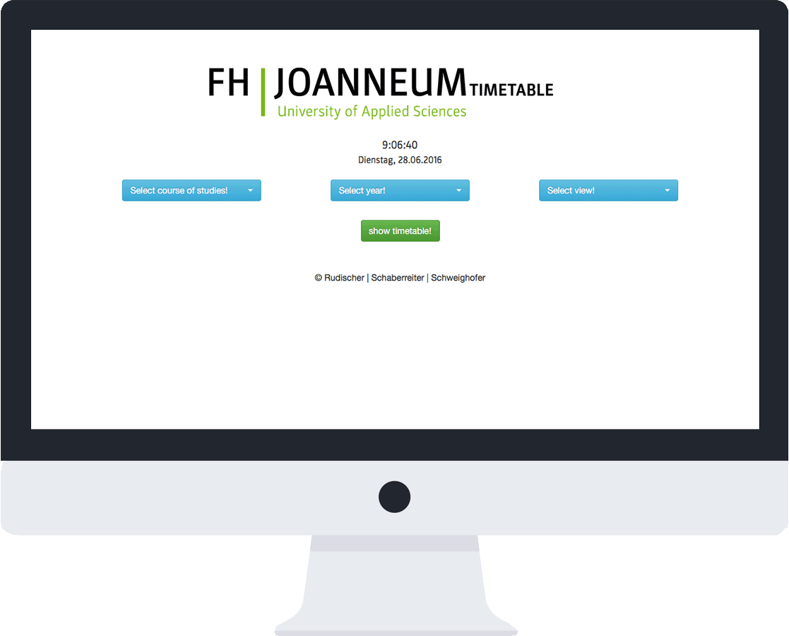
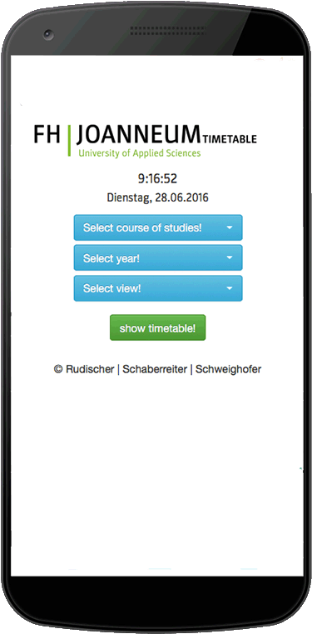
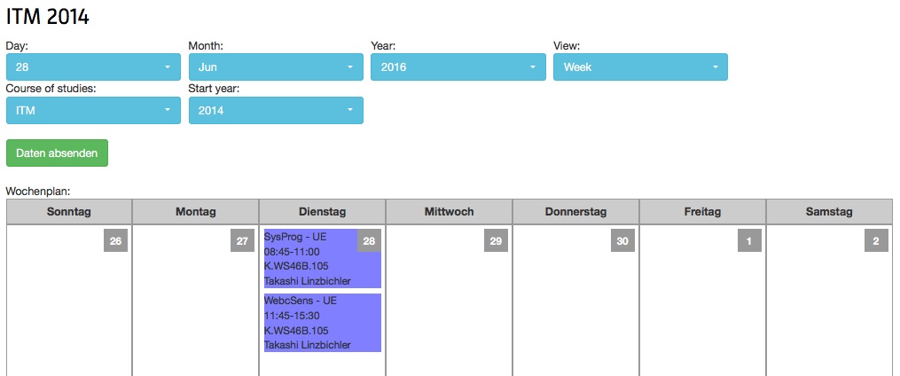
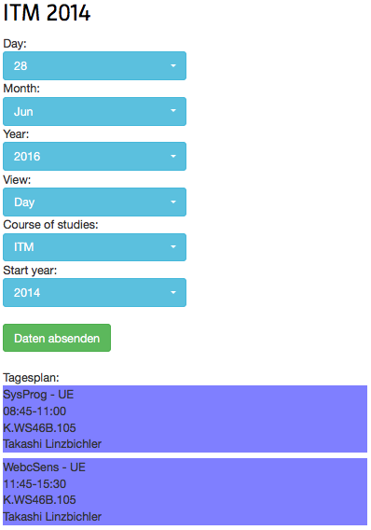
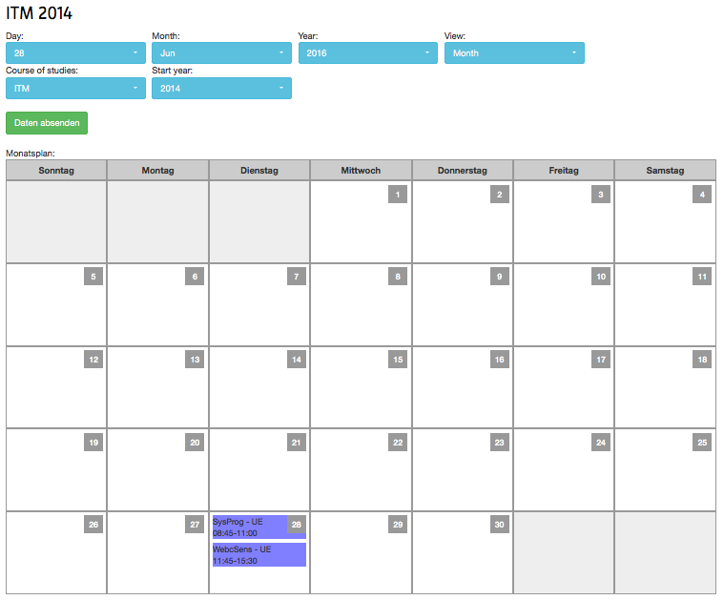
A simple web application which provides a timetable after selecting a course of studies and a year.
ITM 14
Rudischer, Schaberreiter, Schweighofer
DAY/WEEK/MONTH VIEW

